Slide 1
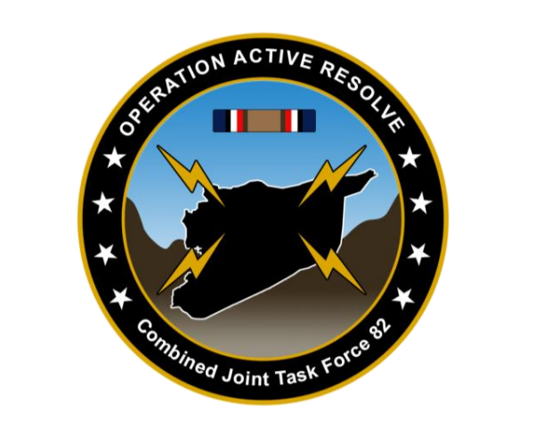

OPAR VIS –Targeting Presentation – Pre D7
DISCLAIMER:
This is for multiplayer online gaming using the Digital Combat Systems simulation software published by Eagle Dynamics. The information is not in any way suitable for real world use or operations.

Slide 2
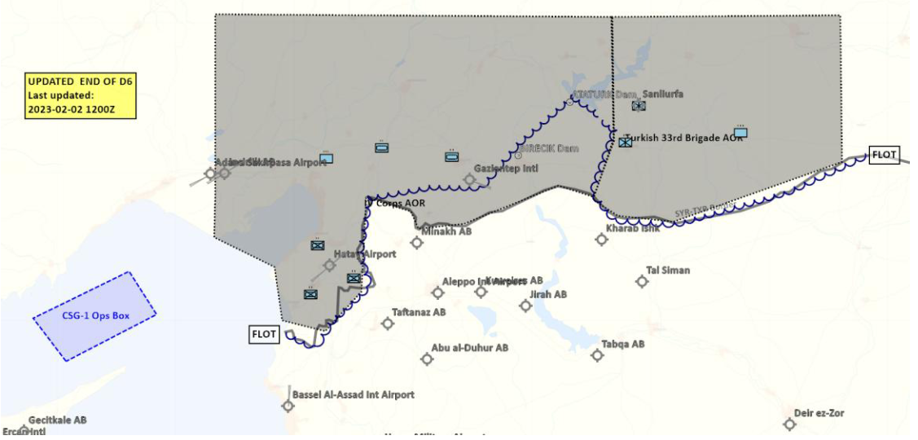
FRIENDLY SITUATION
LAND COMPONENT COMMAND (LCC)
IV Corps:
- 55th Mechanized Division has secured HATAY and have moved forward battalions to screening positions along the FLOT
- 56th Armor Division has its forward elements at the southern outskirt of Gaziantep. 56th is conducting its offensive to capture Gazientiep and free Turkish territory
Turkish Local Forces:
Turkish 33rd Brigade have withdrawn their frontline forces to the city (N37 09.000 E038 48.000) in order to set up defenses to prevent Syrian forces to continue to capture the airfield at Sanliurfa.
Turkish local forces are in static defensive positions and are not in a position to assume offensive operations.
Turkish local forces consist of BTR-80 and M-113s vehicles
Turkish local forces are reinforced with coalition JTACs to support with CAS to defend against Syrian attacks.
OPAR 2 VIS –Targeting Presentation – Pre D7
DISCLAIMER:
This is for multiplayer online gaming using the Digital Combat Systems simulation software published by Eagle Dynamics. The information is not in any way suitable for real world use or operations.

Slide 3
FRIENDLY SITUATION
MARITIME COMPONENT COMMAND (MCC)
CSG-1 continues to support the mission from CSG-1 operations box (same as D5)
SAG-1 have been directed to head west in the Mediterranean due to sinking of a ship carrying ordnance for JFACC
DISCLAIMER:
This is for multiplayer online gaming using the Digital Combat Systems simulation software published by Eagle Dynamics. The information is not in any way suitable for real world use or operations.

Slide 4
FRIENDLY SITUATION
Special Operations Component Command (SOCC)
SOF teams are standing by to support with reconnaissance as required and requested by JFACC/VIS.
SOF team inserted to observe and report at: 922nd SCUD regiment Base (SYTGT003)
SOF team inserted to observe and report at: South Aleppo Rocket Fuel factory (SYTGT137)
SOF team inserted to observe and report at: Tartus (SYTGT056)
SOF teams are also on standby to conduct counter terrorism missions and counter
insurgency operations.
DISCLAIMER:
This is for multiplayer online gaming using the Digital Combat Systems simulation software published by Eagle Dynamics. The information is not in any way suitable for real world use or operations.

Slide 5
INVENTORY
Ordnance list not updated yet
We are still low on all GPS guided munitions, something that will affect operations for D7
Pilots will be tasked with SCLs from D7 onwards
Pilots will be requested to limit the use of external fuel tanks whenever possible as JFACC will try to acquire additional numbers
JFC has reported a small batch of PGMs will be available for D7, amount and types are as of yet unknown
JFACC is finalizing the ordnance list for phase 2 and onwards
DISCLAIMER:
This is for multiplayer online gaming using the Digital Combat Systems simulation software published by Eagle Dynamics. The information is not in any way suitable for real world use or operations.

Slide 6
JFC Guidance
Guidance from JFC
Directions and Guidance or orders received with guidance
Priority of effort is on establishing Air Superiority in support of LCC and set conditions for own operations:
Start shaping for phase 2 in the operation (Create permissive environment)
Continue support to LCC
JFC is working with political leaders to get an agreement to use airbases in Iraq during parts of phase 2. Airbases in question are H3, H3 Northwest. H3 Southwest. What can we achieve by using these bases?
What assets to relocate
JFACC will need to work with the 176th to establish operating procedures and documents
A parallel effort is being made to ensure overflight rights over Lebanon or Israel for any carrier-based aircraft.
No time-estimate, but points 2 and 3 above will not happen until Phase 2 at the earliest!
DISCLAIMER:
This is for multiplayer online gaming using the Digital Combat Systems simulation software published by Eagle Dynamics. The information is not in any way suitable for real world use or operations.

Slide 7
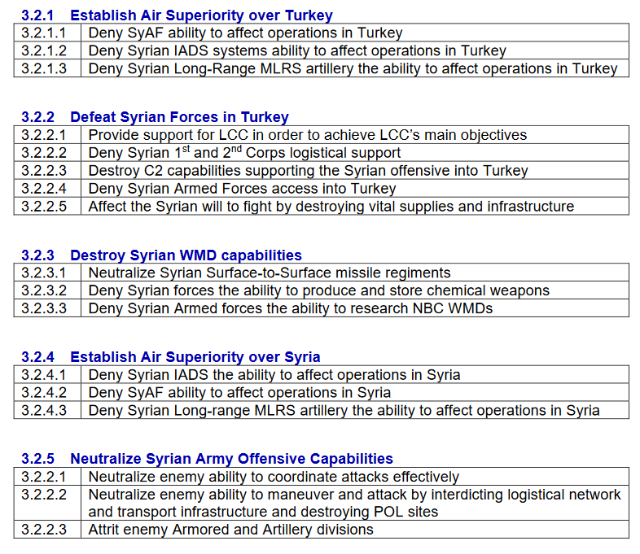


JFACC Status
During D6, JFACC supported the LCC on the battlefield to help LCC achieve its objectives.
Other missions were to strike SCC East and gather intel IVO Shayrat and Tiyas Airbases. Both missions failed.
JFACC expects to continue supporting this effort on D7 (3.2.2.1):
Air Requests from LCC (Pending)
SCAR/AR ivo Minakh and Hatay in order to further attrit enemy forces in the region
JFACC is expecting taskings to support continued air superiority over Turkey (3.2.4.1 3.2.4.2):
Strike SCC East
Execute operations to shape the environment to strike Shayrat, Tiyas and Palmyra ABs
JFACC is expecting to engage targets of opportunity (TSTs):
SCUD/WMD
DISCLAIMER:
This is for multiplayer online gaming using the Digital Combat Systems simulation software published by Eagle Dynamics. The information is not in any way suitable for real world use or operations.

Slide 8
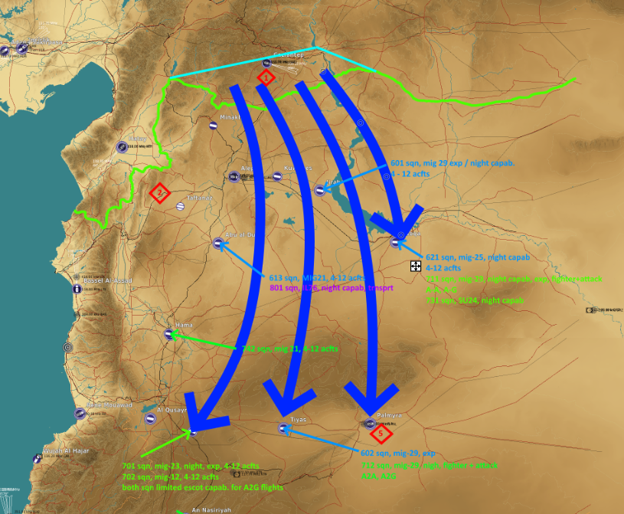
JFACC Goals
JFACC has formulated short, medium and long term goals.
SHORT TERM (+/- 2 days)
Destroy SCC East
Shape operations to strike Shayrat, Tiyas and Palmyra ABs
Gather intel on IADS sector South
MEDIUM GOALS (+/- 2-4 days)
Strike Shayrat, Tiyas and Palmyra ABs
Strike targets in northern Syria that support the war effort
LONG TERM GOALS (+/- 4 – 8 days)
Strike IADS sector South
Use Iraqi airbases to support missions in southern Syria
DISCLAIMER:
This is for multiplayer online gaming using the Digital Combat Systems simulation software published by Eagle Dynamics. The information is not in any way suitable for real world use or operations.

Slide 9


D7 Weather Report
D7.1: Dawn, broken clouds, winds from the North-East
D7.2: Night, clear skies, winds from the North-East
D8.1: Day, clear skies, winds from North-East
D8.2: Dusk, clear skies, winds from North-East
D9.1: Day, broken clouds, winds from North-East
D9.2: Dusk, broken clouds, winds from North-East
(i.e. two-day window with pretty good weather – may become a factor from D9)
DISCLAIMER:
This is for multiplayer online gaming using the Digital Combat Systems simulation software published by Eagle Dynamics. The information is not in any way suitable for real world use or operations.
Notes:
9

Slide 10
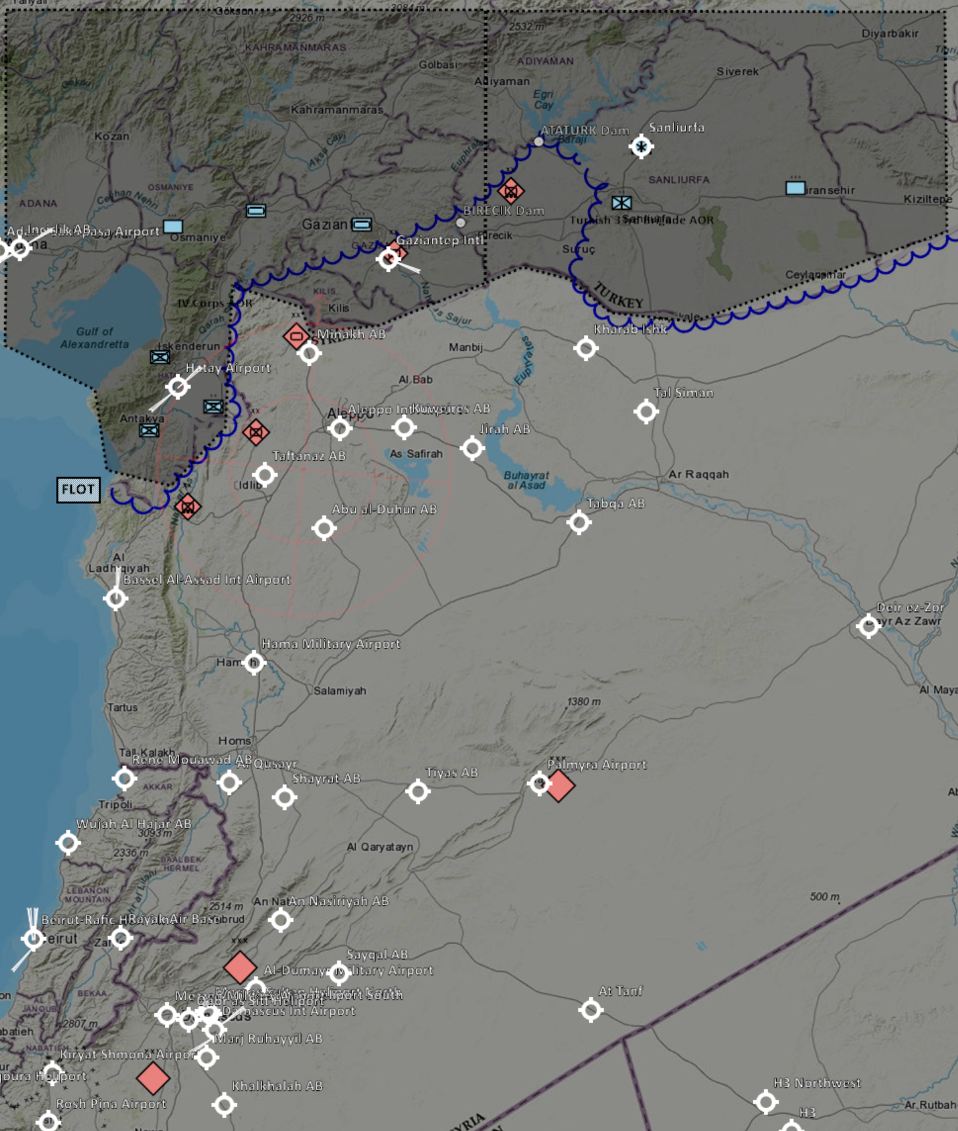
D6 Enemy Situation/BDA - Ground
Strikes on army HQ Buildings in Aleppo mean deployment of 5th Corps is VERY LIKELY to be delayed, along with mobilisation of 6th Corps
Recent destruction of 1st Corps HQ, 11th Div HQ and damage to 12th DIV HQ mean further attacks by 1st Corps units are UNLIKELY over the next few days, and coordination of brigades is VERY LIKELY to be severely hampered.
Significant attrition of 11th Mechanised Division at Gaziantep has now begun:
81% of BMP-2s remain
63% of tube artillery remains
EVEN CHANCE remaining rocket artillery is a single GRAD, or a single GRAD and 2 x SMERCH (neither observed firing D5.2)
SA-15s and SA-8s all destroyed. Significant numbers of SA-13 and GUNDISH remain.
Significant attrition of 10th Armoured Division at Minakh
85% of T-72s remain
53% of tube artillery remains
Remaining rocket arty consisting of 2 x GRAD, 2 x URAGAN and 2 x SMERCH remain a significant threat and their destruction should be prioritised.
2 x SA-15 and 2 x SA-8 remain in the area along with numerous SA-19 and GUNDISH.
Numerous recent observations of armoured formations moving north along road just west of Gaziantep. Assessed LIKELY this is a brigade preparing for a counterattack against our forces IVO Gaziantep.
12th Mot DIV reduced to 2 effective Bdes
One continues to hold Birecik Dam
One remains IVO Attaturk Dam, supported by 2 x GRAD, and now reinforced by detatched Bde from 10th Armour DIV
2 x SA-15 remain near the damaged HQ IVO Birecik Dam
Little attrition and little recent contact with 2nd DIV near Hatay:
21st Mech DIV assessed still holding defensive positions east of Hatay (in the absence of any observations otherwise from our forces in the area).
22nd Motorised division assessed still holding defensive positions south of Hatay. Observations of SAMs indicate no movement of HQ or GRAD units.
If resources allow, an attack on the GRAD units would reduce the pressure on our forces at Hatay, and destruction of the HQs would reduce the chances of an attack on Hatay.

Slide 11
D5 Enemy Situation/BDA - Ground
5th Corps is a big deal!
2 x Armour DIV (includes a total of 8 x SA-15)
1 x Mech DIV (includes 4 x SA-15)
1 x Mot DIV (includes 4 x SA-15)
Heavy Rocket Arty Regt
Air Defence DIV (1 x SA-6 + 2 x SA-11)
Arrival of this Corps provides many options to the Syrians, and the new air defenses can severely impede our ability to provide air support to LCC.
Deployment timescale expected between 4-7 days. Could consider sending SOF team to monitor activity at the base in Palmyra to give warning of movement.
DISCLAIMER:
This is for multiplayer online gaming using the Digital Combat Systems simulation software published by Eagle Dynamics. The information is not in any way suitable for real world use or operations.
Notes:
11

Slide 12
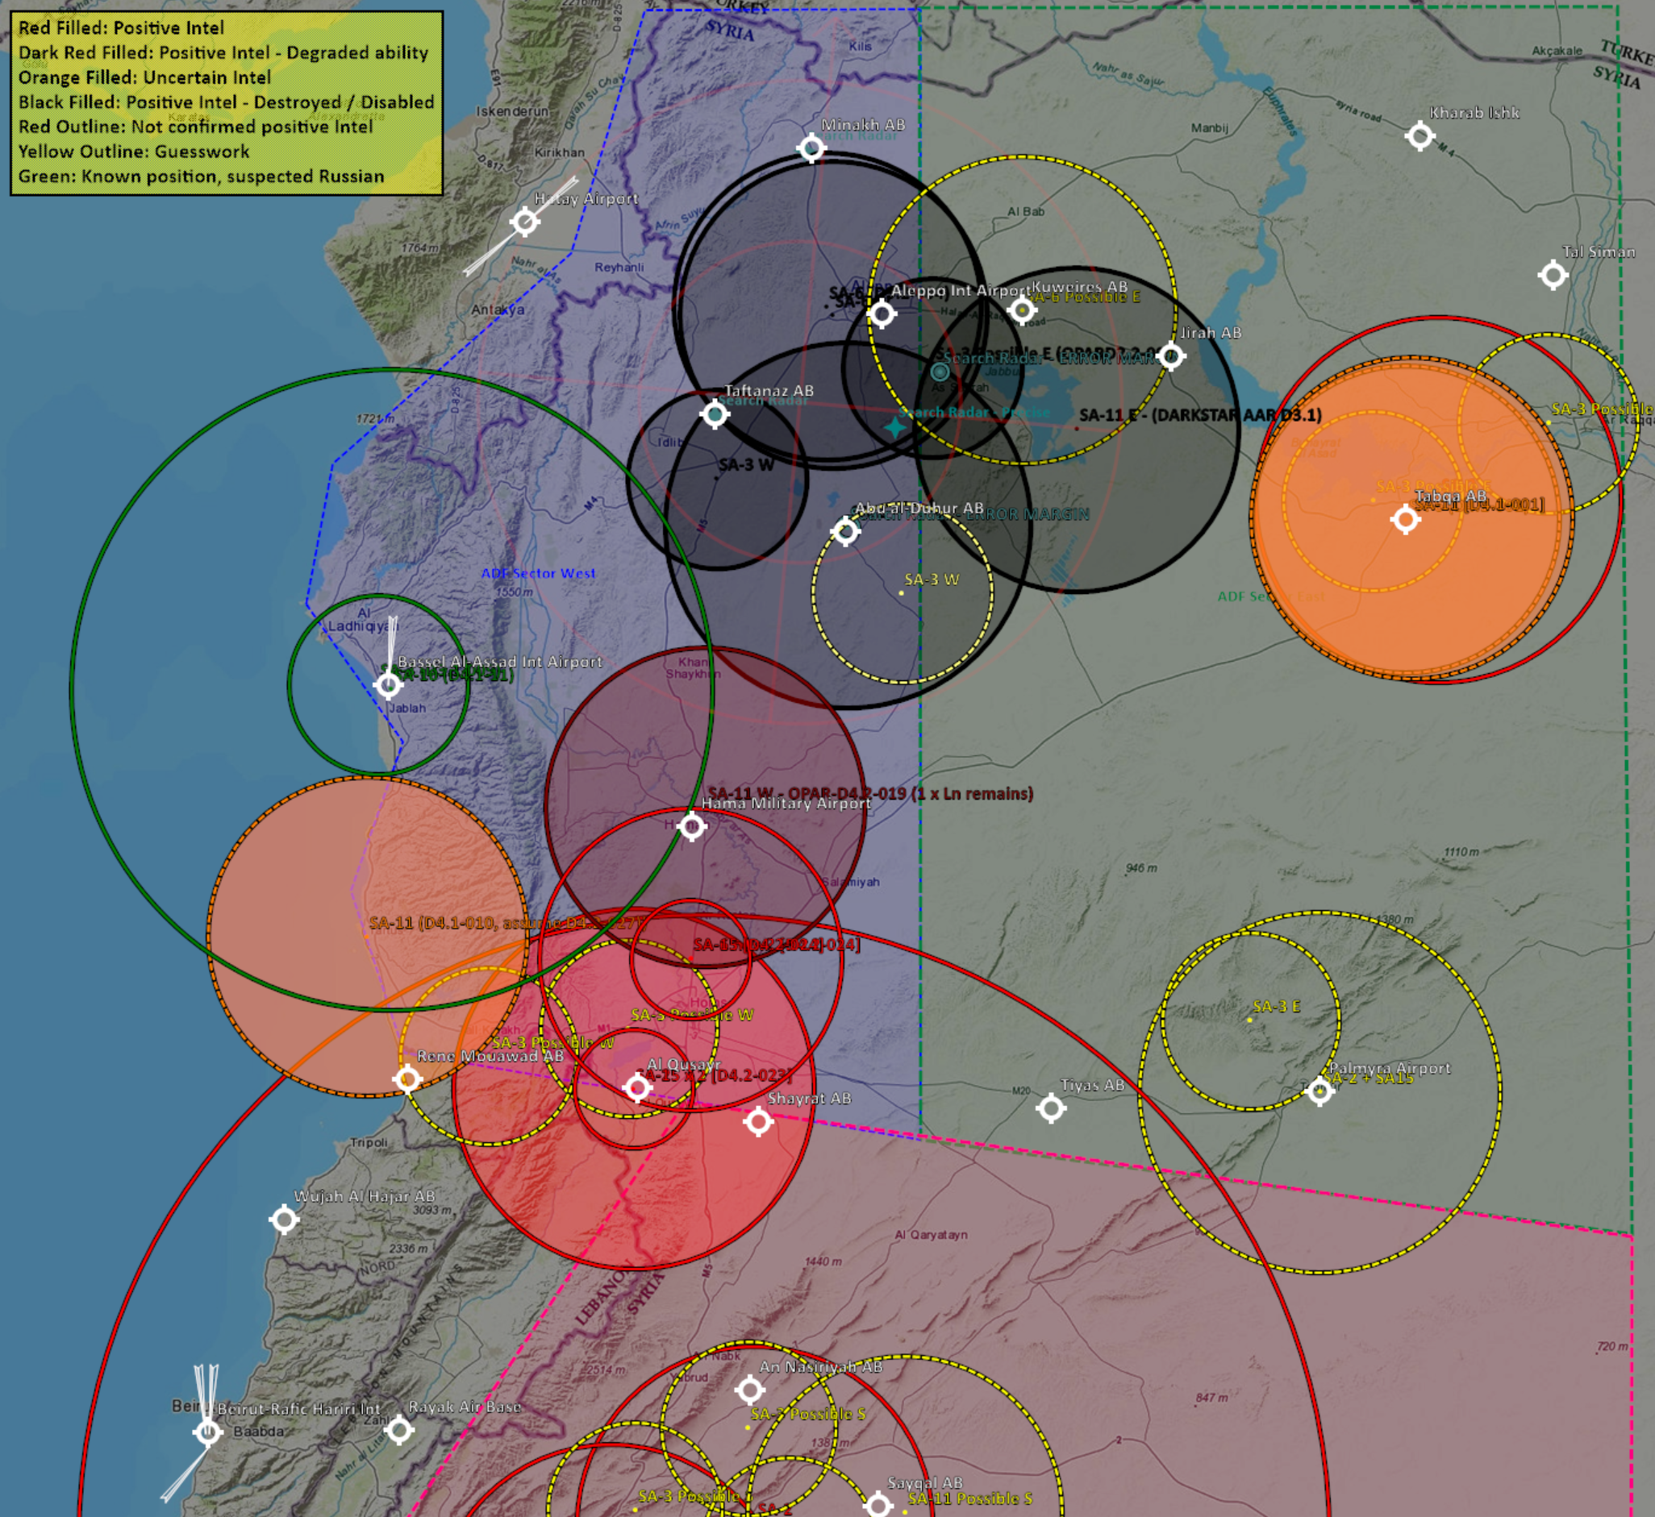
D5 Enemy Situation/BDA - IADS
No change in IADS situation.
In Sector West:
Friendly air units continue to enjoy freedom to manoeuvre in the north of the sector and attrit any enemy SAM units that deploy here.
Further units remain in the south of the sector around Tartus and Homs. Indications of new units near Homs – likely at Air Defence Academy.
Assessed LIKELY that no backup SCC exists in this sector based on pilot observations of SAM behaviour.
In Sector East
3 x SA-3 sites degraded (loss of SR) or disabled (loss of SR and TR), plus one SA-11 disabled.
2 x SA-2, 1 x SA-3, 2 x SA-6 and 1 x SA-11 remain fully operational. Only 1 x SA-2 location known for certain. SA-6 and -11 observed on D3.1 not seen since
Moving SA-2 may move to protect Palmyra in south-east of sector due to arrival of new MiG-29s.
In Sector South, no changes. IADS still fully operational.
DISCLAIMER:
This is for multiplayer online gaming using the Digital Combat Systems simulation software published by Eagle Dynamics. The information is not in any way suitable for real world use or operations.
Notes:
12

Slide 13
D5 Enemy Situation/BDA - IADS
VIS still recommends on-call SEAD as a minimum (or SEAD organic to package) for strike missions into Syrian territory due to the mobility of SA-6 and SA-11 systems (approx. 30 mins to pack up, a few hours drive within sector, 30 mins to set up – able to reposition within sector between our events).
Several IADs units assessed to be at or soon to be at the Air Defence Academy (TGT062) (SA-15s, SA-2, possible SA-6) . Recommend targeting this in the next 1-2 days to slow the replacement of long range and medium range SAM units and maintain our advantage.
DISCLAIMER:
This is for multiplayer online gaming using the Digital Combat Systems simulation software published by Eagle Dynamics. The information is not in any way suitable for real world use or operations.
Notes:
NECK COMMENT: Typically VIS do not belive. VIS assess. For example: We (or VIS) assess that SCC is destroyed.
And when something is not certain VIS can use words to indicate that. See section 4.2.4, table 7 in VIS TTP.
13

Slide 14
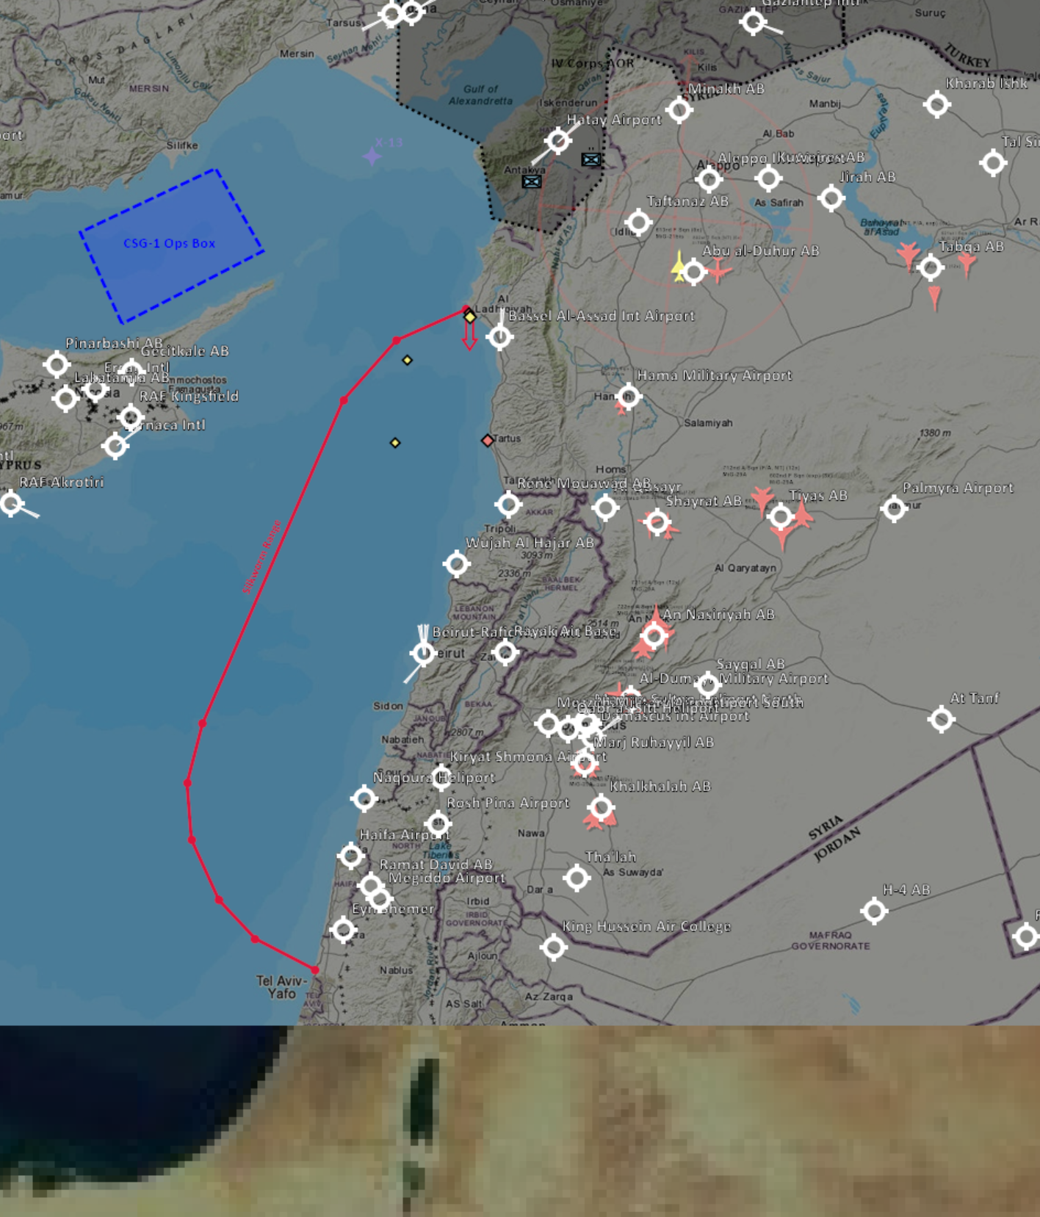
D5 Situation/BDA - Sea
Nothing new to report wrt naval operations
Remaining Syrian units are:
2 x Molniya patrol boat at sea
2 x Rezny frigate – in Tartus
Syrian navy still presents a threat to JCTF logistics.
Significant and growing Russian presence. Currently not known how actively they will enforce the embargo. Chinese SAG en-route but LIKELY will not arrive for some time.
VIS recommendations remain as for D4:
JCTF shipping is routed to stay at least 55 nautical miles from the Lebanese coast
If logistics security becomes a priority, target the Molniyas and Reznys directly
DISCLAIMER:
This is for multiplayer online gaming using the Digital Combat Systems simulation software published by Eagle Dynamics. The information is not in any way suitable for real world use or operations.
Notes:
14

Slide 15
D5 Enemy Situation/BDA - WMDs
622nd Scud Regiment (Aleppo) has moved to Alert Status 1. TELs have moved out of base and into hiding. To launch, they would need to rendezvous with a fuel truck from the storage sights at either the 622nd Base or the Rocket Fuel Factory (both in Aleppo, both under watch by SoF).
No sign of fuel being moved from either location, therefore it is LIKELY that the fuel storage remains a critical vulnerability of the WMD system.
Remaining Scud Regiments (both near Damascus) have moved to Alert Status 2. Able to leave base at 30 mins notice.
SCUD test carried out during D5. It is not currently known where the fuel for this launch came from, as no activity was detected by SOF teams observing Aleppo SCUD base and the Rocket Fuel Factory. No other fuel storage known and currently assumed that some fuel trucks were not at the base when our SOF teams arrived.
Recommend holding back 8 x GBU 31(V)3/B for short-notice strike on WMD oxidiser storage if needed)
DISCLAIMER:
This is for multiplayer online gaming using the Digital Combat Systems simulation software published by Eagle Dynamics. The information is not in any way suitable for real world use or operations.

Slide 16
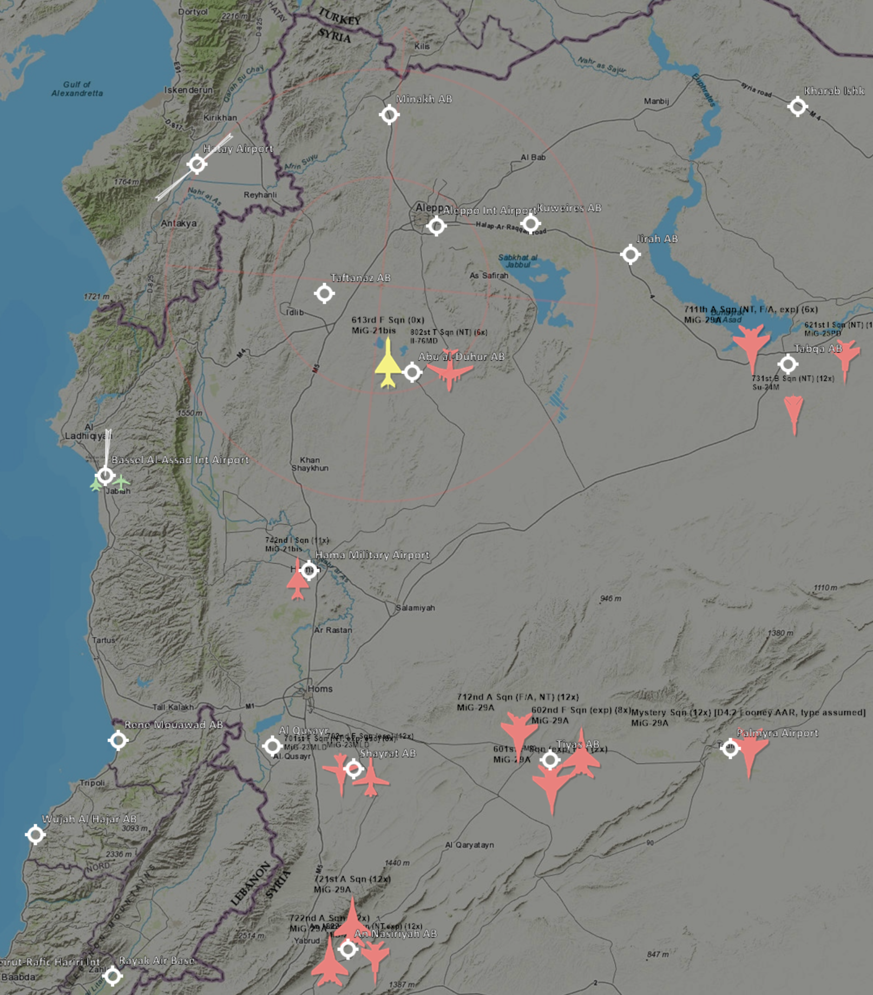
D5 Enemy Situation/BDA - Air
Air picture is largely unchanged since D4. Little contact during D5.
Tabqa appears not operational. Assessed LIKELY due to destruction of all fuel storage and without significant Syrian logistics effort will persist until D11 (low confidence!)
Hama AB runway was also hit. VERY LIKELY Non-operational until D9.
Attrition of another MiG-23 at Shayrat. 19 remain.
8 x MiG-29 observed landing at Palmyra D4.2. LIKELY these have been acquired from Russia and a new Squadron is now based at Palmyra. Another 4 aircraft likely on the way or have already arrived unobserved.
Syria’s primary airfields to obstruct JCTF air operations over the next few days are Shayrat (20 x MiG-23), Tiyas (22 x MiG-29) and Palmyra (est. 12 x MiG-29). QRA observed from both Shayrat and Tiyas when encroaching within 80NM.
Unknown if new Palmyra sqn is night capable. Both other airfields have night-capable units.
NEW!
DISCLAIMER:
This is for multiplayer online gaming using the Digital Combat Systems simulation software published by Eagle Dynamics. The information is not in any way suitable for real world use or operations.
Notes:
16

Slide 17
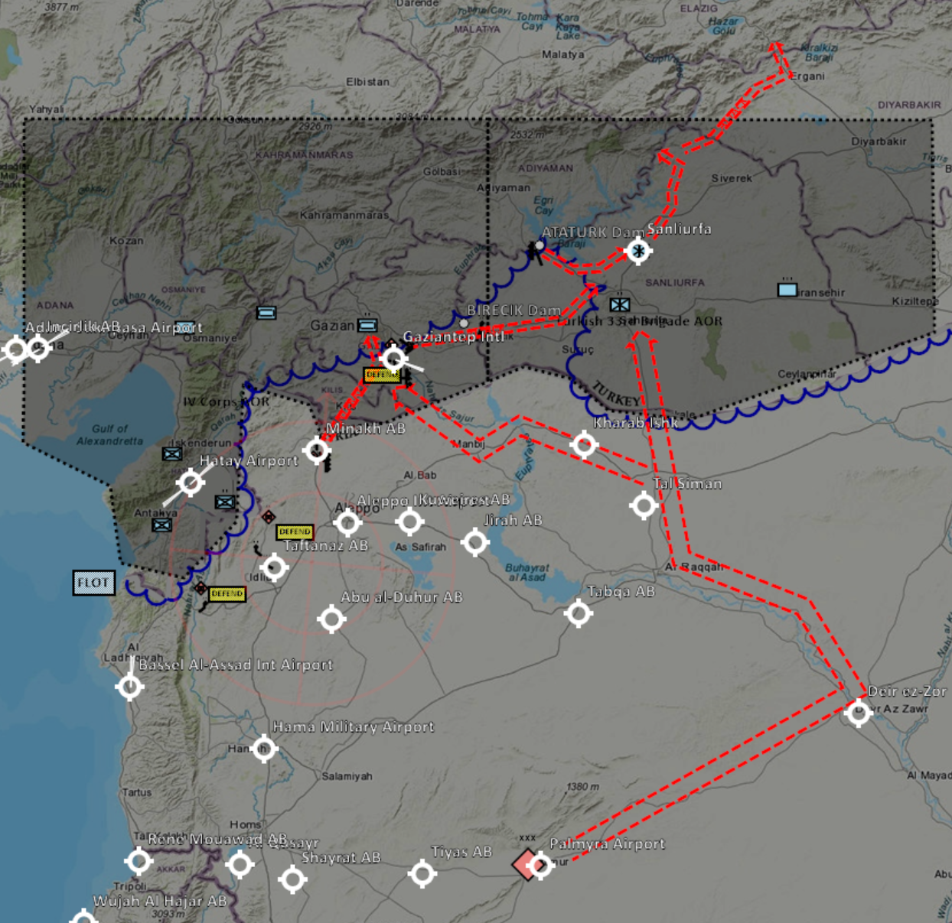
D6 Enemy MLCOA
ML COA – 24 to 72 hrs:
Following severe attrition of army C2, and particularly 1st Corps C2, it is assessed that 1st Corps units will not commence new offensives, and brigades will be poorly coordinated.
Gaziantep
11th DIV attempts to defend airfield, focussing remaining tube arty on pinch-points to slow the advance and inflict losses. The primary aim is likely to be to delay JCTF forces to buy time for the 5th Corps to deploy.
Minakh
10th DIV Continues to hold Minakh with one brigade
Second brigade moving north preparing to counterattack Gaziantep (assessed LIKELY that such plans will already have been made, and brigade C2 will continue to execute those orders. However, with the loss of the Corps HQ coordination with 10th DIV forces will be hampered).
Birecik/Attaturk/Sanliurfa
12th DIV and detached armour brigade take up defensive positions and continue to stage for attack on Sanliurfa once C2 is restored.
Hatay
2nd Corps units continue to hold defensive positions, protecting 1st Corps flank and harassing friendly forces at Hatay with GRADs.
DISCLAIMER:
This is for multiplayer online gaming using the Digital Combat Systems simulation software published by Eagle Dynamics. The information is not in any way suitable for real world use or operations.
Notes:
NECK COMMENT: Are there other objectives that might be relevant for 12th DIV? or have they reached a point where they are happy or can not continue the offensive?
17

Slide 18
D6 Enemy MLCOA
ML COA – 24 to 72 hrs:
Signs of pending invasion of Syrian territory (e.g. close to Hatay) likely to result in threats to use WMDs on CJTF forces and/or Turkish civilian targets.
Reconfiguration of IADS to maximise cover on key WMD infrastructure (esp. Aleppo)
SA-2 from Jirah redeployed to Palmyra to cover airbase and army base.
Airforce Assault Sqns deployed chiefly in A2A role to replace losses. CAP out of Tiyas AB, Shayrat AB and Palmyra AB.
Navy aims to enforce embargo, with Molniyas and Reznys aiming to stay within IADS coverage except when intelligence received about JTCF logistics shipping.
Syria have motivation for Russia to become more involved in the conflict and will likely look for opportunities to exploit ambiguity and potential for confusion. Russia can provide indirect support to their ally by creating ambiguous situations that make use of JCTF reluctance for conflict with Russia to escalate. VIS assess it is LIKELY that Russia will increase activity in the region even if not providing direct support in the form of attacks on JCTF forces or shipping: more flights from Syria, Egypt and Iraq, and increased naval activity.
DISCLAIMER:
This is for multiplayer online gaming using the Digital Combat Systems simulation software published by Eagle Dynamics. The information is not in any way suitable for real world use or operations.
Notes:
NECK COMMENT: Are there other objectives that might be relevant for 12th DIV? or have they reached a point where they are happy or can not continue the offensive?
18

Slide 19
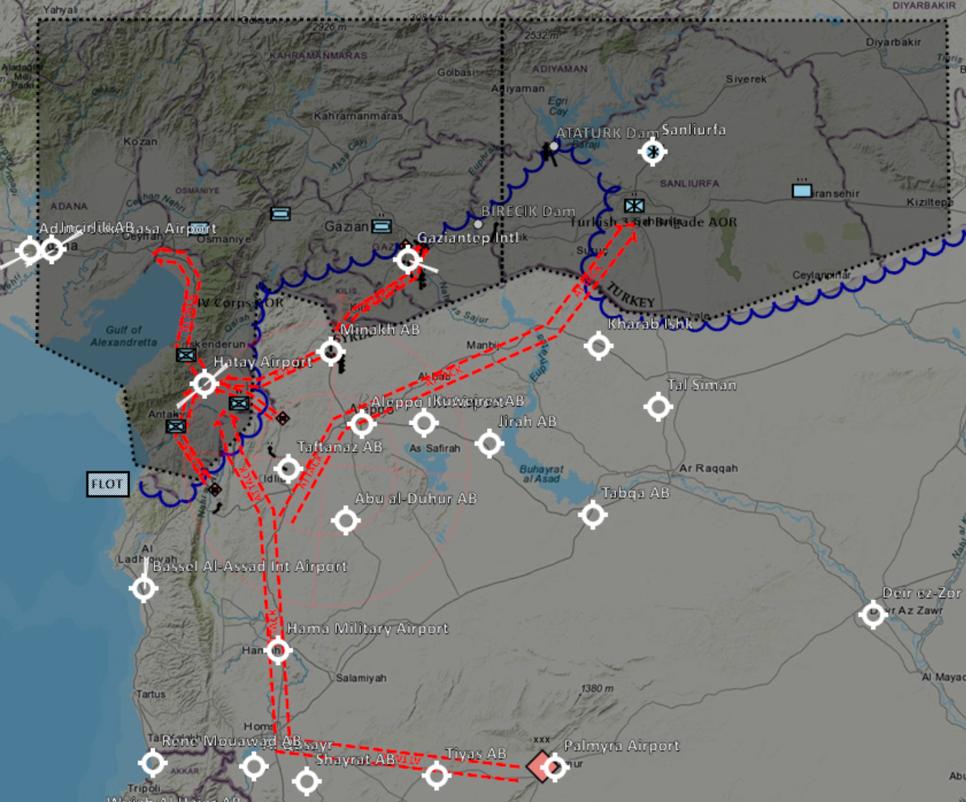
D6 Enemy MDCOA
MD COA – 24 to 72 hrs:
11th DIV defends Gaziantep Intl
2nd Corps launch attack on Hatay with the aim of ultimately driving far enough north to endanger Incirlik AB
10th DIV holds the third brigade in reserve ready for a counterattack on the 56th DIV.
12th DIV holds ground IVO Birecik and Attaturk Dam to allow force to be concentrated on repelling JCTF forces. Detached armoured brigade counterattacks Gaziantep forces from the east.
DISCLAIMER:
This is for multiplayer online gaming using the Digital Combat Systems simulation software published by Eagle Dynamics. The information is not in any way suitable for real world use or operations.
Notes:
NECK COMMENT: Typically the MD COA are slightly more different than the ML COA. A tool VIS can use to identify if the enemy og for ML or MD COA is to try to identify indicators on what seperates the two COAs. So if there are 4 indicators on MD COA and 4 on ML COA, and then on the next ATO Day pilots reporting help answer 3 of the indicators on MD COA and 1 or none on ML COA, then VIS can say with a higher confidence that the enemy is going for the enemy COA, and JFACC then need to plan for that.
To seperate more, something like this for example:
12th ML: Establish defensive positions, rearm, refuel and stay IVO Ataturk Dam
12th MD: Continue attack to other objectives.
11th ML: Static in defensive positions
11th MD: Supporting 12th in offensive operations to subesequent objectives
10th ML: Static preparing for counteroffensive as reserve
10th MD: Moving up and reinforcing 11th (free up so they can attack)
2nd Corps ML: Static defensive positions
2nd Corps MD: Attacking Hatay
5th Corps ML: Stay in base training and preparing
5th Corps MD: Moving to replace 10th (free up so 10th can take 11th position)
19

Slide 20
D6 Enemy MDCOA
MD COA – 24 to 72 hrs:
IADS units redeployed north to provide greater defence in depth and prevent easy CJTF access to strategic targets, as well as improving their air-force’s prospects providing effective CAP.
Airforce redeploys fighter/interceptor squadrons further north to alternative airfields within IADS coverage, and spreads night-capable squadrons more evenly to avoid reliance on particular airfields.
Southern SCUD regiments moved to alert state 1 and deploy to hiding places. 922nd SCUD Regiment used to attack Incirlik and other targets with conventional warheads, disrupting ability of CJTF to project air power
Syrian navy exploits Russian support for embargo and absence of CJTF SAG to attack CSG with Molinyas, with Reznys providing support.
Syria conducts cyber-attacks on CJTF assets, causing further disruption to logistics
DISCLAIMER:
This is for multiplayer online gaming using the Digital Combat Systems simulation software published by Eagle Dynamics. The information is not in any way suitable for real world use or operations.
Notes:
NECK COMMENT: Typically the MD COA are slightly more different than the ML COA. A tool VIS can use to identify if the enemy og for ML or MD COA is to try to identify indicators on what seperates the two COAs. So if there are 4 indicators on MD COA and 4 on ML COA, and then on the next ATO Day pilots reporting help answer 3 of the indicators on MD COA and 1 or none on ML COA, then VIS can say with a higher confidence that the enemy is going for the enemy COA, and JFACC then need to plan for that.
To seperate more, something like this for example:
12th ML: Establish defensive positions, rearm, refuel and stay IVO Ataturk Dam
12th MD: Continue attack to other objectives.
11th ML: Static in defensive positions
11th MD: Supporting 12th in offensive operations to subesequent objectives
10th ML: Static preparing for counteroffensive as reserve
10th MD: Moving up and reinforcing 11th (free up so they can attack)
2nd Corps ML: Static defensive positions
2nd Corps MD: Attacking Hatay
5th Corps ML: Stay in base training and preparing
5th Corps MD: Moving to replace 10th (free up so 10th can take 11th position)
20

Slide 21
D6/7 Targeting Recommendations
AR IVO Minakh in priority order:
Remaining SA-15s, to make permissive for A2G specialists
Remaining rocket arty (2 x SMERCH, 2 x URAGAN, 2 x GRAD (and accompanying SA-8s)) to limit Syrian ability to strike behind our lines
C2 if observed (DIV or Bde HQs – NOT hospitals!), to further degrade ability to carry out coordinated or offensive actions
MBTs, especially if they look like they might be heading north
Support LCC with CAS in accordance with his priorities. Main threats assessed to be:
Tube arty within 15km of pinch points
Armoured units approaching from Minakh or Birecik
Continue to degrade IADS to allow strategic targets to be hit more easily and provide more permissive environment for CAP to operate. Specifically:
TGT062 (Air defence academy IVO Homs, a critical node in deploying new air defense units to replace losses)
SA-2 and other SAMs IVO Tabqa (to keep it vulnerable to later strikes so it stays out of the game), or any SAMs relocating to the north of their sectors
Units in the south of Sector West to improve access to Damascus area and the airbases that are currently operational
If resources permit:
Destroy 2nd Corps HQ, 21st and 22nd DIV HQs and their GRADs, along with any SA-15s in that area to prevent 2nd Corps from harassing or attacking our forces at Hatay
Further strikes on IADS elements or Shayrat/Tiyas airbases
No known inbound logistics shipping for D6. No clear need for targeting naval assets today.
DISCLAIMER:
This is for multiplayer online gaming using the Digital Combat Systems simulation software published by Eagle Dynamics. The information is not in any way suitable for real world use or operations.
Notes:
21

Slide 22
D6 Current TST List
VIS recommend that SCUDs and their fuel trucks stay on the TST list at this point. No other target would be worth deviating from the planned mission to engage.
DISCLAIMER:
This is for multiplayer online gaming using the Digital Combat Systems simulation software published by Eagle Dynamics. The information is not in any way suitable for real world use or operations.

Slide 23
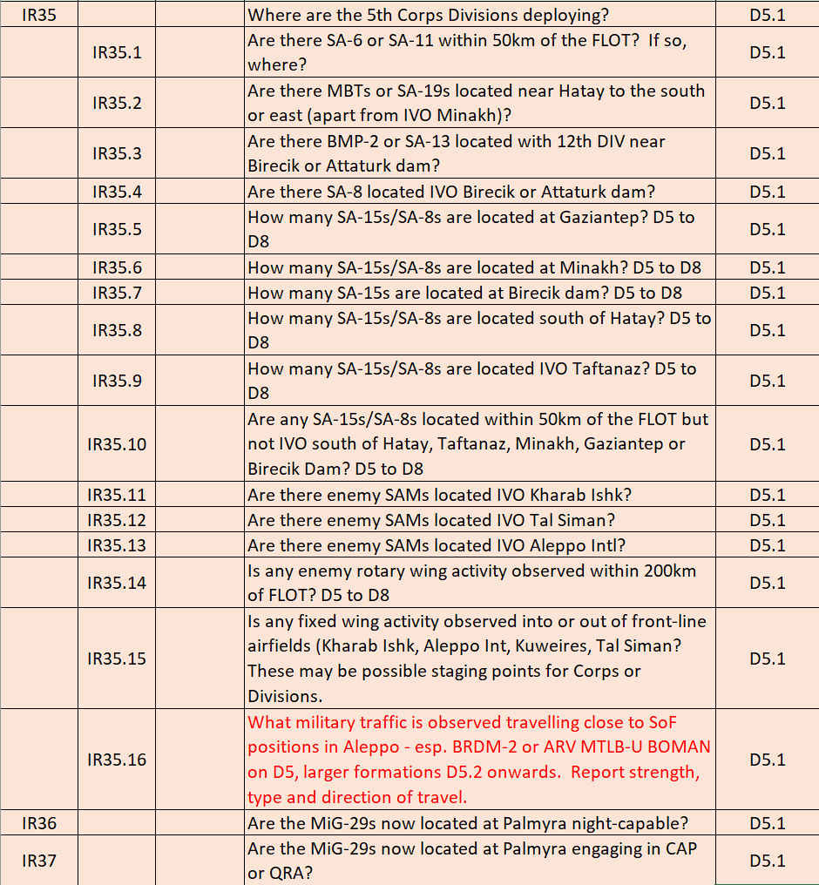
D6 Intelligence Requirements
Full list provided in separate Excel sheet.
New ones for D6 focus on:
COA for 10th DIV brigades at Minakh and Birecik/Sanliurfa
DISCLAIMER:
This is for multiplayer online gaming using the Digital Combat Systems simulation software published by Eagle Dynamics. The information is not in any way suitable for real world use or operations.
Notes:
NECK COMMENT: Suggest to screenshot the legacy IR list, and og through it quickly so JFACC is aware and can try to task flights as needed
NECK COMMENT: As mentioned under D3 Enemy COA, having indicators that help identify if enemy goes for ML or MD COA can be a tool to help. IF able to identify such indicators, then having them as IR can help JFACC to task flights to support your information gaps.
23

Slide 24
D6 Vulnerable SYTGT
Syrian operational targets that are currently not well protected by Syrian counter-air assets:
SYTGT001 - Syrian Army HQ Building 1 – destruction would prevent deployment or movement of Corps-sized units for 4 to 7 days, and ability to conduct an offensive using more than one Corps will be removed.
SYTGT002 - Syrian Army HQ Building 2 – destruction would delay mobilisation by 4-7 days, and cause chaos in the mobilisation and deployment of forces.
SYTGT003 – 622nd Scud Regt. Base – destruction now has reduced impact as TELs are in the field, but fuel and oxidiser storage is one of only two such sites known.
SYTGT137 – Rocket Fuel Factory – destruction would prevent manufacture of more Scud fuel/oxidiser, and storage on-site is one of only two such sites known.
SYTGT100 – Syrian Naval HQ – destruction would severely impact coordination of maritime operations and reduce flow of supplies by sea, including loading oil for export, by 50%
SYTGT005 – Syrian Navy Storage – destruction would increase duration of navy repairs
SYTGT081 – Al Safira Military Research Centre – destruction would significantly hamper military research including biological weapons
SYTGT088 – Syrian Intelligence Office Jirah – destruction reduces Syrian ability to coordinate air strikes on friendly ground forces
SYTGT119 – Al Assad Ammo Storage – impact unknown – one of three known ammo storage sites
SYTGT075 – 1st Corps Army Base – destruction would reduce morale of 1st Corps units
Ammo factories totalling 67% of Syrian MLRS production capacity (2 locations), 50% of unguided bomb and 100% of PGM production capacity (1 location and 100% of AAA/small-arms ammo production capacity (1 location)
Vehicle factories totalling 100% of current truck production capacity (1 location), 40% of current BMP/BTR/Scud TEL production capacity (1 location), and final assembly of MiG-21 or MiG-23 (1 location)
Chemical weapons production facility
Oil storage targets totalling 21 days fuel for the Syrian army and 1060 air sorties (2 locations) – civilian impact likely high
Various power plants/distribution, food processing, grain storage etc, each with civilian impacts if destroyed.
DISCLAIMER:
This is for multiplayer online gaming using the Digital Combat Systems simulation software published by Eagle Dynamics. The information is not in any way suitable for real world use or operations.
Notes:
24

